Slide 1

Visualization with Matplotlib
By Muhammad Umair Baig Data & AI Trainer

Slide 2
Introduction to Matplotlib
Matplotlib is a multiplatform data visualization library built on NumPy arrays, part of the broader SciPy stack.
Conceived by John Hunter in 2002 as a patch to IPython for MATLAB-style interactive plotting.
Released version 0.1 in 2003 after John decided to develop it independently.

Slide 3
Key Features of Matplotlib
Works across multiple operating systems and supports various graphics backends.
Supports dozens of backends and output types, ensuring compatibility and flexibility.
Large user base and active developer community contribute to its tools and ubiquity in scientific Python.

Slide 4
Challenges and Modern Alternatives
Interface and style are perceived as outdated compared to newer tools like:
ggplot and ggvis (R language).
Web-based visualization libraries (e.g., D3.js, HTML5 canvas).
Despite this, Matplotlib remains a strong, well-tested, cross-platform graphics engine.

Slide 5
Adaptation and Evolution
Recent versions allow easier customization of global plotting styles (e.g., style sheets).
Modern packages build on Matplotlib’s core to provide cleaner APIs, such as:
Seaborn.
ggpy, HoloViews.
Pandas as a wrapper around Matplotlib.
Direct use of Matplotlib’s syntax is still valuable for precise adjustments.

Slide 6
Importance of Matplotlib
Despite competition, Matplotlib is likely to remain a crucial component of the Python data visualization ecosystem.
Modern tools complement rather than completely replace Matplotlib, ensuring its continued relevance.

Slide 7
Importing Matplotlib
Just as we use the np shorthand for NumPy and the pd shorthand for Pandas, we will use some standard shorthands for Matplotlib imports:
import matplotlib as mpl
import matplotlib.pyplot as plt

Slide 8
Setting Styles
We will use the plt.style directive to choose appropriate aesthetic styles for our figures. Here we will set the classic style, which ensures that the plots we create use the classic Matplotlib style:
plt.style.use('classic')

Slide 9
show or No show? How to Display Your Plots
A visualization you can't see won't be of much use, but just how you view your Matplotlib plots depends on the context.
The best use of Matplotlib differs depending on how you are using it; roughly, the three applicable contexts are using Matplotlib in a script, in an IPython terminal, or in a Jupyter notebook.

Slide 10
Plotting from a Script
Purpose of plt.show:
Starts an event loop to display active figures in interactive windows.
Example Script (myplot.py):
import matplotlib.pyplot as plt
import numpy as np
x = np.linspace(0, 10, 100)
plt.plot(x, np.sin(x))
plt.plot(x, np.cos(x))
plt.show()

Slide 11
Running the Script:
Execute from the command line:
$ python myplot.py
Opens a window with the figure(s) displayed.
Behavior of plt.show:
Interacts with the system's graphical backend, handling backend-specific details.
Should be used only once per Python session, typically at the script's end.
Caution:
Multiple plt.show calls can cause unpredictable behavior depending on the backend.

Slide 12
Plotting from an IPython Shell
IPython Compatibility:
Matplotlib integrates seamlessly with the IPython shell.
Activating Matplotlib Mode:
Use the %matplotlib magic command:
%matplotlib
Using matplotlib backend: TkAgg
Workflow in IPython:
After enabling the mode, import Matplotlib:
import matplotlib.pyplot as plt
Any plt plot command will open a figure window.

Slide 13
Updating Plots:
Some changes (e.g., modifying drawn line properties) do not auto-update.
Use plt.draw to force a manual update.
No Need for plt.show:
plt.show is unnecessary in IPython's Matplotlib mode.

Slide 14
Plotting from a Jupyter Notebook
Jupyter Notebook Overview:
A browser-based tool combining narrative, code, graphics, HTML, and more into an executable document.
Interactive Plotting in Notebooks:
Use %matplotlib magic command, similar to the IPython shell.
Options for embedding graphics:
%matplotlib inline: Static images of plots embedded in the notebook.
%matplotlib notebook: Interactive plots embedded in the notebook.

Slide 15
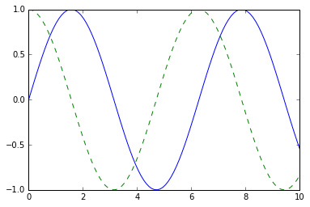
Example with Static Embedding:
%matplotlib inline
import numpy as np import matplotlib.pyplot as plt
x = np.linspace(0, 10, 100)
fig = plt.figure() plt.plot(x, np.sin(x), '-') plt.plot(x, np.cos(x), '--');

Slide 16
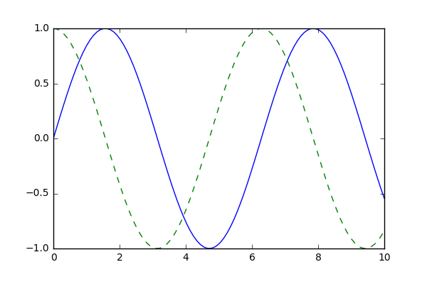
Saving Figures to File
Use savefig to save figures in various formats.
Example to save a plot as a PNG file:
fig.savefig('my_figure.png')
Generates my_figure.png in the current working directory.
Confirm Saved Content:
from IPython.display import Image
Image('my_figure.png')

Slide 17
Supported File Types:
File format inferred from the file extension.
Check supported formats using: fig.canvas.get_supported_filetypes()
Examples of supported formats:
PNG, JPEG, PDF, SVG, EPS, TIFF, and more.
Key Note:
plt.show or similar commands are not necessary when saving figures.

Slide 18
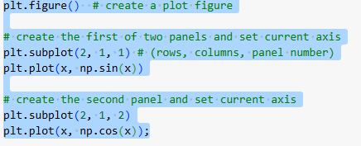
Two Interfaces for the Price of One
MATLAB-Style Interface
Designed as a Python alternative for MATLAB users, using a stateful, convenient interface via pyplot (plt).
Example code with two panels:
Keeps track of the "current" figure and axes using plt.gcf (get current figure) and plt.gca (get current axes).

Slide 19
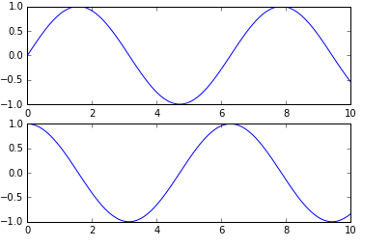
Limitations:
Issues arise when modifying previous panels or axes after creating new ones.
While possible, it can be clunky for complex plots.

Slide 20
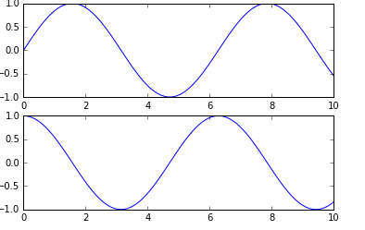
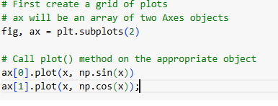
Object-Oriented Interface
Overview:
Provides more control over figures and axes, especially for complex plots.
Plotting functions are methods of explicit Figure and Axes objects.

Slide 21
Advantages:
Avoids reliance on an "active" figure or axes.
Necessary for complicated plots requiring precise control.
Comparison and Usage
Simple Plots: Either style works, and preference determines choice.
Complex Plots: Object-oriented approach becomes essential.

Slide 22
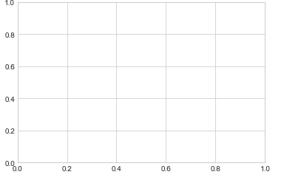
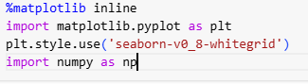
Simple Line Plots
Creating a Simple Plot
Setup: Import necessary libraries and enable inline plotting.
Creating a figure and axes:
The figure is a container for all plot elements, and axes is the area where the plot is drawn.

Slide 23
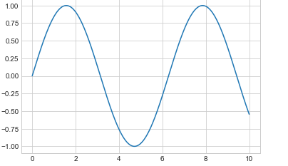
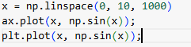
Plotting a simple sinusoid:
Define an array of x-values and plot the corresponding sine values.
plt.plot(x, np.sin(x)) Automatically creates a figure and axes without explicitly defining them.

Slide 24
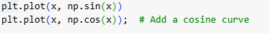
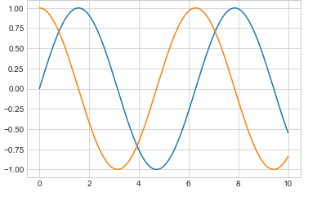
Plotting multiple lines:
Call plt.plot multiple times to add more lines to the same plot.

Slide 25
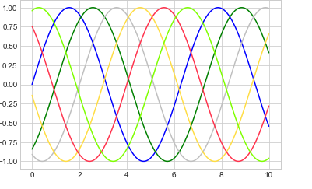
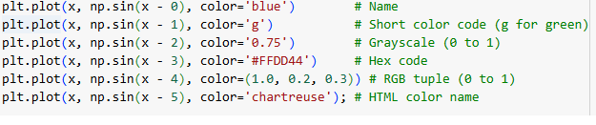
Adjusting Line Colors and Styles
Customizing colors: Use the color argument to specify line colors in different formats:
If no color is specified, Matplotlib cycles through default colors.

Slide 26
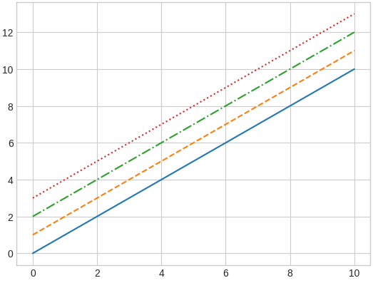
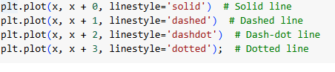
Customizing line styles:
Use linestyle to adjust the appearance of the line.

Slide 27
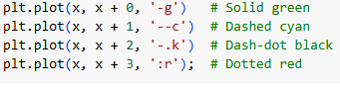
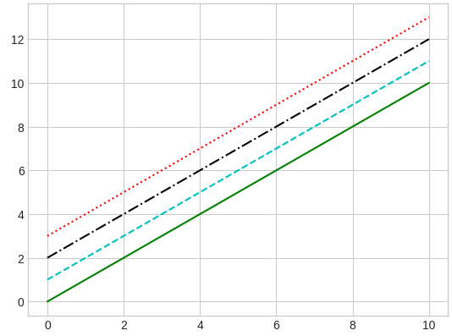
Combining styles and colors:
Save effort by combining line styles and colors in shorthand.

Slide 28
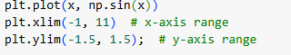
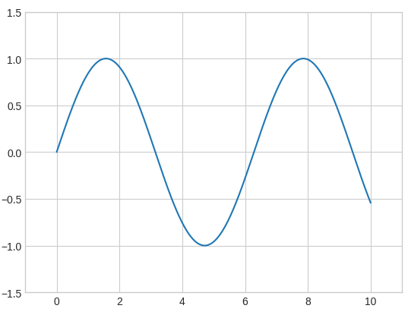
Adjusting Axes Limits
Matplotlib automatically adjusts axes limits, but you can override them:
Manual limits:

Slide 29
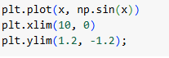
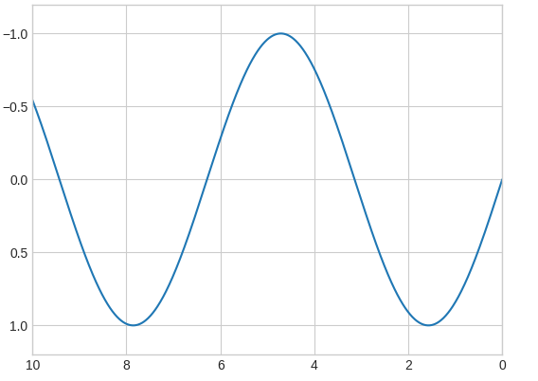
Reversing axes: Reverse the order of arguments to flip an axis direction.

Slide 30
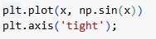
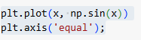
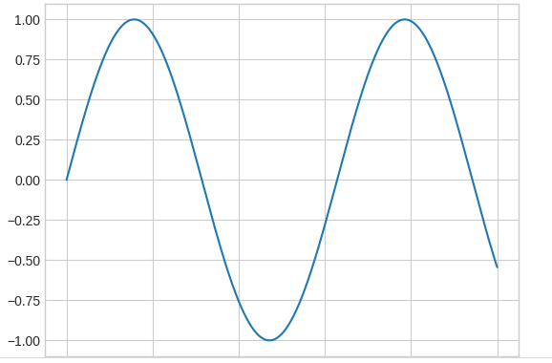
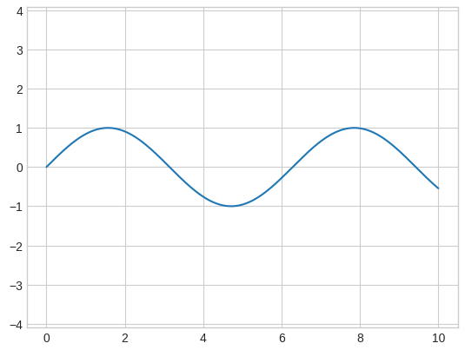
Automatic adjustments:
tight: Shrinks axes to fit the data snugly.
equal: Ensures equal aspect ratio for x and y.

Slide 31
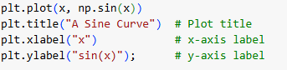
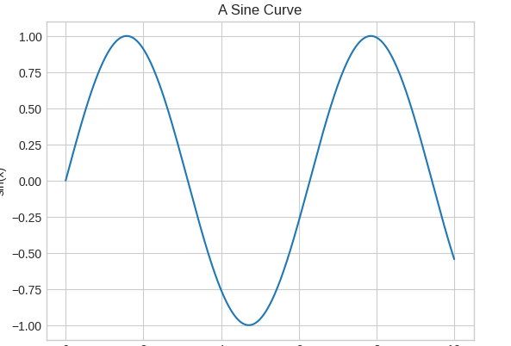
Labeling Plots
Add descriptive titles and axis labels to enhance clarity:
Title and axis labels:

Slide 32
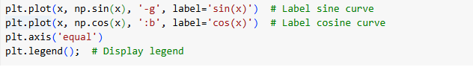
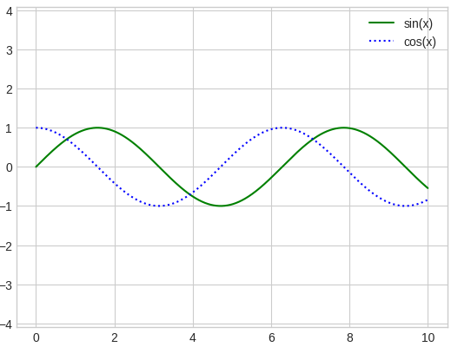
Legends:
Use plt.legend to identify different lines in a plot.

Slide 33
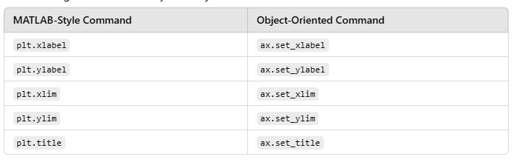
Matplotlib Gotchas
Transitioning from MATLAB-style to object-oriented commands:

Slide 34
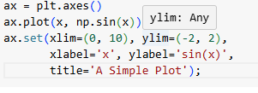
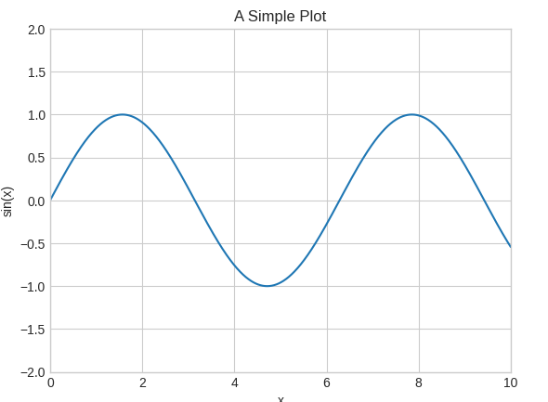
Setting multiple properties at once:
The object-oriented interface simplifies setting properties.

Slide 35
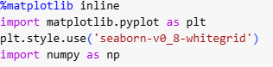
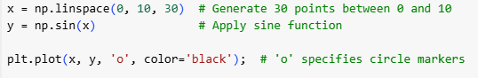
Simple Scatter Plots:
Setup
To create scatter plots, begin by importing necessary libraries and setting the style:
Scatter Plots with plt.plot
The plt.plot function is versatile, allowing scatter plots by specifying marker styles.

Slide 36
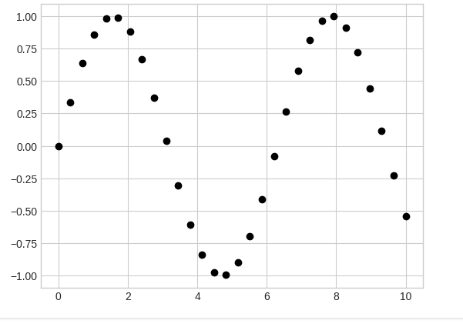
Explanation: The 'o' argument defines the marker style as circles. The color='black' argument sets the marker color.
Graph: Points are displayed as black circles without connecting lines.

Slide 37
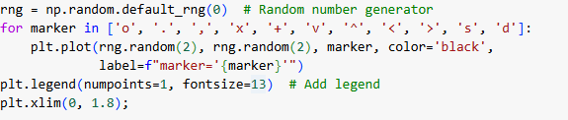
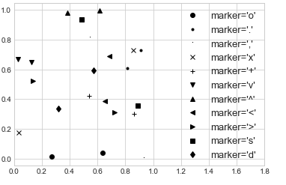
Marker Styles
You can experiment with various marker styles like 'x', '^', s, etc.
The loop iterates over marker styles.
The label argument identifies each marker in the legend.
The plt.legend() function displays a legend for the markers.

Slide 38
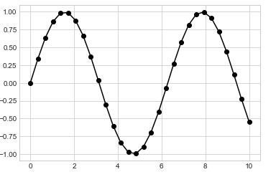
Combining Markers with Lines
Markers can be used alongside lines for enhanced visuals.
'-ok': Combines a solid line (-), black color (k), and circle markers (o).

Slide 39
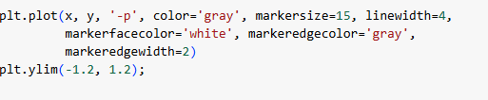
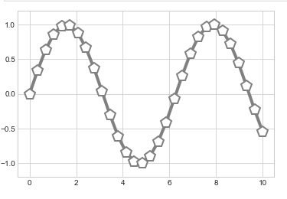
Customizing Marker Appearance
Markers can be adjusted further using properties like size, edge color, and face color.
markersize=15: Enlarges markers.
linewidth=4: Thickens the connecting line.
markerfacecolor='white': Sets the marker fill color to white.
markeredgecolor='gray': Sets the marker edge color to gray.
markeredgewidth=2: Sets the thickness of the marker edge.

Slide 40
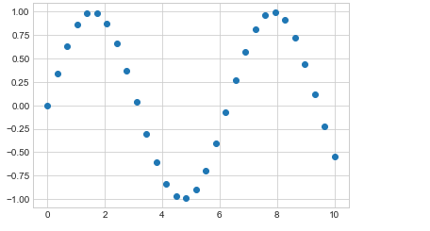
Scatter Plots with plt.scatter
The plt.scatter function offers more flexibility for scatter plots, allowing per-point customization.
Explanation: The plt.scatter function plots the same points as plt.plot, but with more customization options.

Slide 41
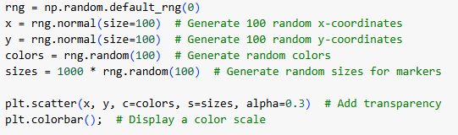
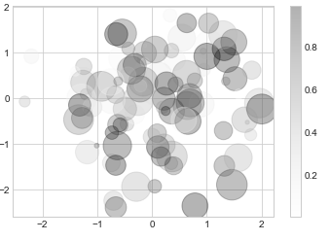
Customizing Points
Scatter plots can convey additional information using point size, color, and transparency.
c=colors: Sets the color of each point based on an array.
s=sizes: Sets the size of each point.
alpha=0.3: Makes points partially transparent.
plt.colorbar(): Adds a color bar to explain the color mapping.

Slide 42
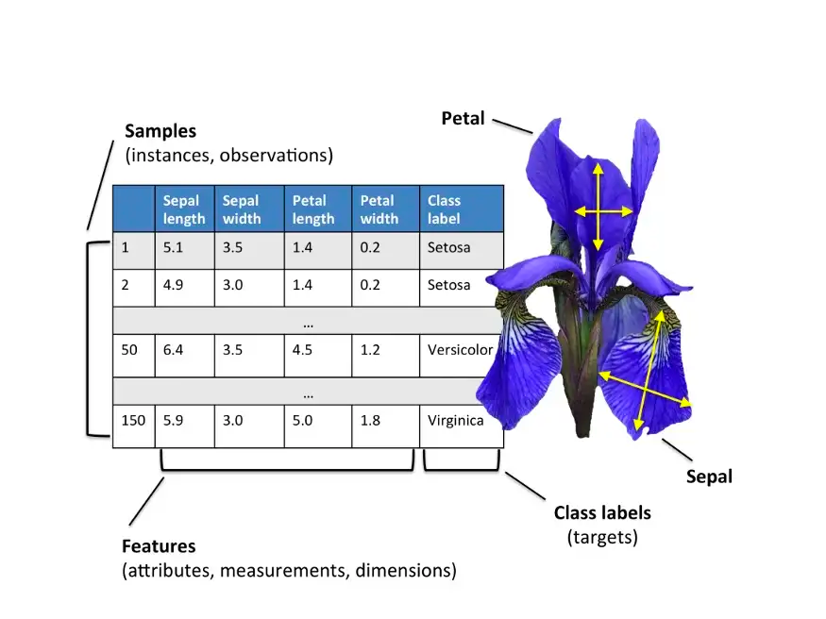
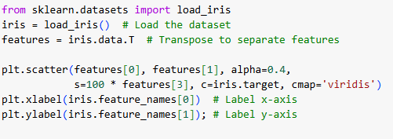
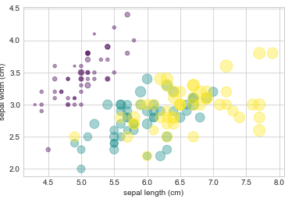
Multidimensional Data with plt.scatter
Scatter plots are excellent for visualizing multidimensional datasets.
Example: Iris Dataset
X-axis → Sepal length.
Y-axis → Sepal width.
Point size → Petal width.
Point color → Flower species.
cmap='viridis': Sets the colormap for color mapping.

Slide 43
Multidimensional Data with plt.scatter
Scatter plots are excellent for visualizing multidimensional datasets.
Example: Iris Dataset
X-axis → Sepal length.
Y-axis → Sepal width.
Point size → Petal width.
Point color → Flower species.
cmap='viridis': Sets the colormap for color mapping.

Slide 44
Efficiency: plt.plot vs plt.scatter
plt.plot: More efficient for large datasets; markers are uniform, reducing rendering overhead.
plt.scatter: Slower but allows customization of individual points (size, color, etc.).
Performance Tip
Use plt.plot for datasets with thousands of points, and plt.scatter when detailed customization is required.

Slide 45
Visualizing Uncertainties
Importance of Visualizing Uncertainties
Accurate reporting of uncertainties is crucial for interpreting scientific measurements.
Example:
Without uncertainties: A measured value of 74 (km/s)/Mpc compared to a literature value of 70 (km/s)/Mpc cannot be assessed for consistency.
With uncertainties: Adding uncertainties like 70 ± 2.5 and 74 ± 5 allows quantitative analysis of consistency.

Slide 46
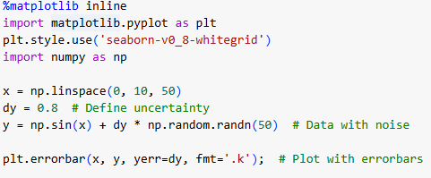
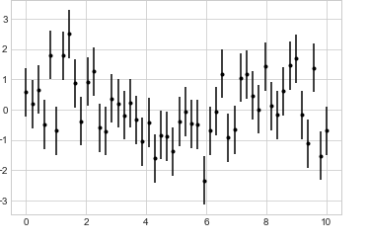
Basic Errorbars
Errorbars are a standard way to represent uncertainties visually.
yerr=dy: Specifies vertical error magnitude.
fmt='.k': Defines marker style (.) and color (k for black).
Graph: Points with vertical errorbars.

Slide 47
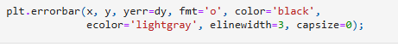

Customized Errorbars
color='black': Black marker color.
ecolor='lightgray': Light gray errorbar color.
elinewidth=3: Thicker errorbar lines.
capsize=0: Removes caps at the ends of errorbars.
This customization enhances clarity, especially in crowded plots.

Slide 48

Continuous Errors
For continuous quantities, uncertainty can be visualized using a shaded region.
Gaussian Process Regression: Fits a flexible model to the data, providing predictions (yfit) and associated uncertainties (dyfit).

Slide 49


Visualizing Continuous Errors
plt.fill_between: Fills the area between the bounds of uncertainty.
yfit - dyfit and yfit + dyfit: Define the lower and upper bounds.
alpha=0.2: Sets transparency for the shaded region.

Slide 50
Graph:
Data points in red.
A gray line represents the model fit.
Shaded regions show uncertainty, with wider areas indicating greater uncertainty far from data points.
Use Cases
Errorbars: Ideal for discrete data points with uncertainties.
Continuous Errors: Suitable for functions or predictions with continuous uncertainties.
Tools for Advanced Visualization
plt.fill_between: Customizable and precise for low-level control of shaded error regions.
Seaborn: Offers a more streamlined API for creating similar plots effortlessly.

Slide 51

Density and Contour Plots
Visualizing Three-Dimensional Data in Two Dimensions
Three Matplotlib functions are commonly used for visualizing three-dimensional data in two dimensions:
plt.contour: Line-based contour plots.
plt.contourf: Filled contour plots.
plt.imshow: Image plots with color-coding.
Explanation: The function f(x,y)f(x, y)f(x,y) is defined as a combination of sine and cosine terms for a complex surface.

Slide 52


Generating Data for the Plot
np.meshgrid: Constructs 2D coordinate grids from 1D arrays.
ZZZ: The function values at all points in the grid.

Slide 53
Contour Plots
Basic Line Contours
Explanation:
colors='black': Draws all contours in black.
Graph: Solid lines represent positive values, dashed lines for negative values.

Slide 54

Colormap and Custom Intervals
20: Number of contour levels.
cmap='RdGy': Red-Gray colormap, ideal for data varying around zero.
Graph: Lines are color-coded, providing more intuitive visual differentiation.

Slide 55


Filled Contour Plots
plt.contourf: Creates filled regions between contour levels.
plt.colorbar: Displays a color scale indicating the data range.
Graph: Clearer depiction of "peaks" (black) and "valleys" (red) using filled colors.

Slide 56


Smoothing Discrete Steps
plt.imshow: Provides a smooth 2D representation of ZZZ.
interpolation='gaussian': Smooths the data for continuous shading.
extent=[xmin, xmax, ymin, ymax]: Maps the grid to specific axis ranges.
Graph: A visually smooth surface without discrete contour steps.

Slide 57


Combining Contour and Image Plots
plt.contour and plt.imshow are combined for enhanced visualization.
alpha=0.5: Adds transparency to the background image.
plt.clabel: Labels contours directly on the plot.
Graph: Highlights contours over a smooth color-coded background.

Slide 58
Considerations with plt.imshow
Gridless Axes:
plt.imshow doesn’t use xxx and yyy grids; manual extents must be specified.
Origin:
Defaults to the top-left (origin='upper'). Use origin='lower' for gridded data.
Aspect Ratio:
Automatically adjusts to data; override with aspect='equal'.
Use Cases
plt.contour: Highlight specific data levels.
plt.contourf: Ideal for filled visualizations.
plt.imshow: Suitable for smooth color transitions.
Combining Plots: Achieves detailed and visually appealing representations

Slide 59


Histograms, Binnings, and Density
One-Dimensional Histograms
Histograms provide a visual representation of data distribution. Using Matplotlib's plt.hist function, you can quickly create a histogram.
plt.hist(data): Automatically computes bins and counts.
Graph: Displays a simple histogram of the data distribution.

Slide 60


Customized Histogram
Key Customizations:
bins=30: Specifies 30 equal-width bins.
density=True: Normalizes the histogram.
alpha=0.5: Adjusts transparency.
histtype='stepfilled': Creates a filled step plot.

Slide 61


Comparing Distributions
Multiple datasets are compared using transparency and a consistent style.

Slide 62

Computing Histogram Values
np.histogram: Calculates bin counts without plotting.
Output: Array of counts for each bin.

Slide 63

Two-Dimensional Histograms
Histograms can be extended to two dimensions by dividing data into a 2D grid of bins.
Data is drawn from a multivariate normal distribution.

Slide 64


2D Histogram with plt.hist2d
plt.hist2d: Creates a 2D histogram with square bins.
plt.colorbar: Adds a color scale to represent bin counts.

Slide 65

Computing 2D Histogram Values
np.histogram2d: Computes counts for 2D bins.

Slide 66


Hexagonal Binning with plt.hexbin
plt.hexbin: Uses hexagonal bins instead of squares.
gridsize=30: Specifies the resolution of the hexagon grid.

Slide 67

Kernel Density Estimation (KDE)
KDE is a method for estimating data density by "smoothing" discrete points.
Simple KDE with scipy.stats.gaussian_kde
gaussian_kde: Fits a KDE model to data.
Z: KDE values evaluated on a 2D grid.
Graph: Smooth density visualization with continuous color transitions

Slide 68
Advantages of KDE
Provides a continuous density representation.
Adjusting the smoothing length balances detail and smoothness.
Choosing Between Methods
Histograms:
Best for discrete binning and direct count visualization.
Hexbin:
Useful for large datasets; hexagons improve resolution.
KDE
Ideal for smooth density estimation.

Slide 69


Customizing Plot Legends in Matplotlib
1. Basic Plot Legend
Plot legends are essential for identifying plot elements. A basic legend can be created using the plt.legend() or ax.legend() command.

Slide 70


Customizing Legend Location and Appearance
Specifying Location
loc='upper left': Places the legend in the upper-left corner.
frameon=True: Adds a frame around the legend.

Slide 71


Adjusting Columns
ncol=2: Arranges legend items into two columns.

Slide 72


Adding Rounded Frame and Shadows
fancybox=True: Adds rounded corners to the frame.
framealpha=1: Sets frame transparency (1 = opaque).
shadow=True: Adds a shadow to the frame.
borderpad=1: Increases padding around legend text.

Slide 73


Controlling Legend Items
Manually Specifying Legend Items
lines[:2]: Selects specific lines to include in the legend.
Labels: Custom labels are provided as a list

Slide 74


Using Labeled Plot Elements
Only elements with a label attribute appear in the legend.

Slide 75

Legends for Point Sizes
Sometimes point sizes represent features, like populations or areas. A legend can reflect this by plotting "fake" data points.
Example: City Data

Slide 76


Slide 77


Adding Multiple Legends
Matplotlib only supports one legend per plot by default. To add multiple legends, you can use the ax.add_artist() method.

Slide 78
Key Customization Tips
loc: Specifies position of the legend (e.g., 'upper left', 'center').
frameon: Toggles the frame around the legend.
fancybox: Adds rounded corners.
ncol: Specifies number of columns in the legend.
scatterpoints: Controls the number of points in a scatter legend.

Slide 79


Customizing Colorbars
Colorbars are essential in visualizations for understanding the mapping of data values to colors. Below are various ways to create and customize them:
1. Basic Colorbar
A simple colorbar can be added to a plot using plt.colorbar():

Slide 80


Customizing Colormaps
You can specify a colormap using the cmap argument. For example, to use a blue colormap:
Choosing the Right Colormap
Colormaps fall into three main categories:
Sequential: A single, continuous range of colors. Examples: viridis, Blues.
Divergent: Two contrasting colors representing deviations around a midpoint. Examples: RdBu, PuOr.
Qualitative: Distinct colors with no inherent order. Example: tab10, Set1

Slide 81



Comparing Colormaps
The view_colormap function can visualize the brightness variation of a colormap and its grayscale equivalent.
Example:

Slide 82


Adjusting Color Limits
The extend property allows you to indicate out-of-bound values in the colorbar:
extend='both': Adds arrows at both ends of the colorbar.
plt.clim(-1, 1): Restricts the displayed range of values.

Slide 83


Discrete Colorbars
For discrete values, you can use a discrete colormap:

Slide 84


Example: Handwritten Digits
Dataset Visualization
To visualize the digits dataset from Scikit-Learn:

Slide 85



Dimensionality Reduction
To reduce the dataset to 2D for visualization:
Scatter Plot with Discrete Colorbar
Using the reduced dimensions:
This reveals relationships in the dataset:
Digits like 2 and 3 overlap, indicating potential classification confusion.
Distinct digits like 0 and 1 are well-separated.

Slide 86
Takeaways
Use sequential colormaps for continuous data and divergent colormaps for deviation-based visualizations.
Customize color limits and add extensions to improve clarity.
Use discrete colormaps and tick adjustments for categorical or grouped data.
Advanced visualizations, such as embedding data in 2D, require combining Matplotlib's colormaps with machine learning techniques like manifold learning.

Slide 87


Multiple Subplots
plt.axes: Subplots by Hand
The plt.axes() function allows you to create custom axes with manual positioning. You specify the position and size using a list of four values: [left, bottom, width, height], where the coordinates range from 0 to 1 (relative to the figure's dimensions). You can use this method to create inset axes or custom-shaped subplots.
This approach is flexible and lets you control the exact position of each subplot.

Slide 88


plt.subplot: Simple Grids of Subplots
For creating simple grids of subplots, plt.subplot can be used. It takes three arguments: the number of rows, columns, and the index of the subplot (starting from 1 at the top-left).
You can adjust the spacing between subplots using plt.subplots_adjust to control hspace (vertical spacing) and wspace (horizontal spacing).

Slide 89

plt.subplots: The Whole Grid in One Go
The plt.subplots function is ideal for creating a whole grid of subplots in one call. It returns a NumPy array of axes, and you can share axes across rows or columns using the sharex and sharey parameters. This method simplifies the creation of consistent grid layouts.
You can then access individual subplots using array indexing.

Slide 90


plt.GridSpec: More Complicated Arrangements
plt.GridSpec is used for more complex subplot arrangements where you want to span multiple rows or columns. You can specify the grid layout and then slice it to assign axes to different regions. This provides flexibility in aligning subplots.
You can use GridSpec for advanced plots like scatter plots with marginal histograms (common in Seaborn visualizations), where you arrange multiple axes in a non-standard grid.

Slide 91

Example: Creating a Scatter Plot with Marginal Histograms
In this example, a scatter plot with histograms on the margins is created using GridSpec:

Slide 92

This setup creates a central scatter plot with histograms on the top and right margins, showing the distribution of x and y.

Slide 93
Summary
plt.axes: For precise control over subplot placement.
plt.subplot: Simple grids of subplots.
plt.subplots: Convenient for creating a grid of subplots at once, with optional axis sharing.
plt.GridSpec: For more flexible layouts, such as spanning multiple rows or columns.

Slide 94
Enhancing Visualization with Text
Annotations and labels help make plots more informative and guide the reader through the data. Commonly used annotations include:
Axes labels and titles for basic descriptions.
Custom text labels for highlighting specific data points.

Slide 95

Example: Annotating a Plot of US Births
We use cleaned birthrate data to plot daily average births in the US. Annotations are added to mark notable holidays:

Slide 96

The ax.text() function positions text at a given data coordinate.
Parameters like ha (horizontal alignment) and style control the text's appearance.

Slide 97


Coordinate Transforms for Flexible Placement
Matplotlib uses multiple coordinate systems:
Data coordinates (transData): Position text relative to data values.
Axes coordinates (transAxes): Position text relative to the plot axes (e.g., fractions like (0.5, 0.1)).
Figure coordinates (transFigure): Position text relative to the figure dimensions.
Adjusting the axes limits (ax.set_xlim(0, 2)) demonstrates how only transData coordinates change with the axis.

Slide 98


Adding Arrows and Annotations
For arrows and labels:
Use plt.annotate() instead of plt.arrow() for better flexibility and style control.
Parameters include:
xy: Data point where the annotation points.
xytext: Position of the annotation text.
arrowprops: Style of the arrow.

Slide 99

Complex Annotation Styles
Annotations can use bounding boxes, fancy arrow styles, and custom alignment.

Slide 100


Slide 101
Key Takeaways
Text and arrows help highlight important features in a plot.
Choose the coordinate system (transData, transAxes, or transFigure) based on whether the text should move with the data, axes, or remain fixed.
Use plt.annotate() for flexible, styled arrows and text.

Slide 102


Customizing Ticks
Tick customization allows greater control over the appearance, placement, and formatting of ticks in plots. By fine-tuning ticks, you can enhance the readability and aesthetics of your visualizations. Key components include:
Tick Locations: Where the ticks appear.
Tick Labels: The text associated with the ticks.
Example: Logarithmic Scale
Major ticks display prominent gridlines and labels.
Minor ticks only show small tick marks without labels.

Slide 103

Accessing Tick Locators and Formatters:
Here, major tick labels use scientific notation, while minor ticks are unlabeled (NullFormatter).

Slide 104

Hiding Ticks or Labels
To hide ticks or labels, use NullLocator and NullFormatter.
Example: Hiding Specific Ticks

Slide 105


Slide 106


Example: Image Grid
For images, tick labels often add unnecessary clutter:
All tick labels are hidden for better clarity.

Slide 107


Reducing or Increasing the Number of Ticks
Crowded tick labels can be mitigated using MaxNLocator.
Example: Adjusting Tick Density
This reduces the number of ticks to three per axis, improving readability.

Slide 108


Custom Tick Formats
For more control over tick formatting, use locators like MultipleLocator and custom formatters like FuncFormatter.
Example: Customizing Tick Locations

Slide 109
Example: Custom Tick Labels
import matplotlib.pyplot as plt
from matplotlib.ticker import FuncFormatter
import numpy as np
# Generate data
x = np.linspace(0, 2 * np.pi, 100)
y = np.sin(x)
# Create a plot
fig, ax = plt.subplots(figsize=(8, 4))
ax.plot(x, y, label='sin(x)')
# Define custom tick formatter function
def format_func(value, tick_number):
N = int(np.round(2 * value / np.pi))
if N == 0:
return "0"
elif N == 1:
return r"$\pi/2$"
elif N == 2:
return r"$\pi$"

Slide 110
elif N % 2 > 0:
return rf"${N}\pi/2$"
else:
return rf"${N // 2}\pi$"
# Apply custom tick formatter to x-axis
ax.xaxis.set_major_formatter(FuncFormatter(format_func))
# Add labels, legend, and title
ax.set_xlabel('x-axis (radians)')
ax.set_ylabel('y-axis')
ax.legend()
ax.set_title('Sine Wave with Custom Tick Labels')
# Show the plot
plt.show()
Ticks are labeled in terms of multiples of π\piπ, enhancing interpretability.

Slide 111

Summary of Locators and Formatters

Slide 112


Slide 113

Customizing Matplotlib: Configurations and Stylesheets
1. Plot Customization by Hand
You can tweak individual plot elements for improved visual appeal.
Example: Adjusting the background, gridlines, and axis spines to create a more polished histogram.

Slide 114


Slide 115

2. Changing Defaults with rcParams
Adjust runtime configuration settings for consistent styling across plots.
Use plt.rc() to customize settings like colors, gridlines, tick marks, etc.

Slide 116


Slide 117


Stylesheets
Matplotlib offers built-in stylesheets to easily change the overall appearance of plots.
Use plt.style.use('stylename') to apply a style globally or within a context manager.
Exploring Built-in Styles
Check available styles: plt.style.available.
Example Styles:
Default Style

Slide 118


FiveThirtyEight Style

Slide 119


ggplot Style

Slide 120


Dark Background Style

Slide 121


Grayscale Style

Slide 122


Seaborn Style

Slide 123


Create Custom Styles
Save your configurations in .mplstyle files for reusable custom styles.
Example content of a custom .mplstyle file:

Slide 124
Summary
rcParams: Fine-grained control over plot appearance via runtime configurations.
Stylesheets: Predefined themes for easy application or creation of custom styles.
Experiment with styles to find what works best for your presentation or analysis needs!

Slide 125


Three-Dimensional Plotting in Matplotlib
1. Enabling 3D Axes
Import the mplot3d toolkit to enable 3D plotting:

Slide 126

Three-Dimensional Points and Lines
Line Plot: Use ax.plot3D for 3D line plotting.
Scatter Plot: Use ax.scatter3D to visualize points.
Example

Slide 127



Slide 128


Three-Dimensional Contour Plots
Use ax.contour3D for 3D contours.
Example:

Slide 129


Wireframes and Surface Plots
Wireframe Plot: ax.plot_wireframe

Slide 130


Surface Plot: ax.plot_surface

Slide 131

Surface Triangulations
For irregular data, use ax.plot_trisurf.

Slide 132




Slide 133

Example: Möbius Strip
Parametrize and plot a Möbius strip.

Slide 134



Slide 135
Summary
Use projection='3d' to enable 3D plotting.
Choose appropriate plot types (line, scatter, contour, surface, etc.).
Explore interactive features for enhanced visualization (e.g., ax.view_init).

Slide 136


Visualization with Seaborn
Histograms and Density Plots
Histogram: Visualize the frequency distribution.
Kernel Density Estimation (KDE): A smooth estimate of the distribution.
Joint Density: Shows the relationship between two variables.

Slide 137

Pair Plots
Generalize joint plots to visualize relationships across all variable pairs.

Slide 138


Faceted Histograms
Split data into subsets and visualize them in a grid.

Slide 139

Categorical Plots
Visualize data grouped by categories.

Slide 140



Joint Distributions
Show joint and marginal distributions in one figure.

Slide 141


Bar Plots
Visualize time-series counts or distributions.

Slide 142

Example: Marathon Finishing Times
Data Preparation:

Slide 143


Split vs. Final Time:

Slide 144


Slide 145


Split Fraction:

Slide 146


Violin Plots by Gender and Age:

Slide 147


Linear Regression:

Slide 148
Key Takeaways:
Negative Splits: Few runners achieve negative splits, and they tend to have faster overall times.
Gender Comparison: Men are more likely to have even splits than women.
Age Insights: The split fraction varies across age groups, with older women outperforming other groups in some cases.
Seaborn is a versatile tool for statistical visualization, offering both simplicity and elegance for exploratory data analysis. For further examples, consult the Seaborn documentation.

